Slide 1
Can you believe everything you see?

Slide 2
How can you tell if something you read on the internet is true?

Slide 3
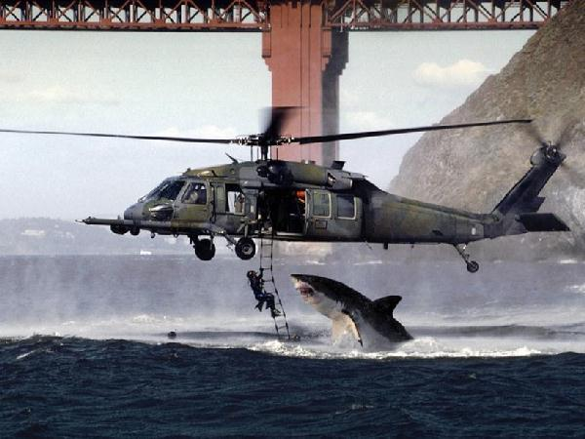

Slide 4
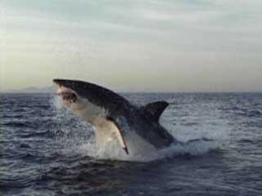

Slide 5
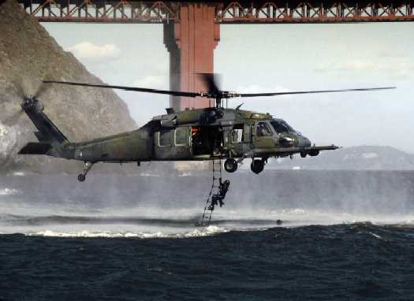

Slide 7
Why should I check my sources?

Slide 8
How can I do this?

Slide 9
Ask yourself these
5 questions
as you begin your search.

Slide 10
The Five W’s of Website Evaluation
Developed by Kathy Schrock
©2001-2009. Kathy Schrock. All rights reserved.
WHO?
WHAT?
WHEN?
WHERE?
WHY?

Slide 11
The Five W’s of Website Evaluation
Developed by Kathy Schrock
©2001-2009. Kathy Schrock. All rights reserved.
WHO?

Slide 12
The Five W’s of Website Evaluation
Developed by Kathy Schrock
©2001-2009. Kathy Schrock. All rights reserved.
WHAT?

Slide 13
The Five W’s of Website Evaluation
Developed by Kathy Schrock
©2001-2009. Kathy Schrock. All rights reserved.
WHEN?

Slide 14
The Five W’s of Website Evaluation
Developed by Kathy Schrock
©2001-2009. Kathy Schrock. All rights reserved.
WHERE?

Slide 15
The Five W’s of Website Evaluation
Developed by Kathy Schrock
©2001-2009. Kathy Schrock. All rights reserved.
WHY?

Slide 16
Directions: Complete this table as you visit each site. If you cannot find the answer, leave it blank. Name:
 | Schrock’s Five W’s of Web Site Evaluation
Website | WHO (Is the author an expert?) | WHAT (What is the author’s purpose?) | WHEN (When was the site created / updated?) | WHERE (Where does the information come from?) | WHY (Why is this information useful?) | Do you trust this site?
http://nationalzoo.si.edu/Animals/default.cfm
http://www.enchantedlearning.com/coloring/

Slide 17
Any Questions?

